Slide 1


5 domains of prevention
Adult Disease Prevention – Average Risk Patient
REMEMBER: Prioritize Screening and Prevention Based On:
Age
Sex
Risk Factors
Psychosocial
Cancer
(See Prev 1)
Infectious Disease
(See Prev 1)
Psychosocial
Cardiovascular disease
Family/Safety
CV disease
Family/ Safety
CASES
ADULT DISEASE SCREENING & PREVENTION

Slide 2
5 domains of prevention
Psychosocial Disorder Prevention – Substance Use Disorders
All adults should be screened for substance use annually
Psychosocial
Alcohol
Tobacco
Illicit Drugs
Substance Use
SASQ
"Do you ever smoke or use other tobacco or nicotine products?"
“How many times in the past year have you used an illegal drug or used a prescription medication for non-medical reasons?”
Mental Health
Do you sometimes drink beer, wine or other ETOH beverages?
How many times in the past year have you had 5 (4 if F) or more drinks in a day?
CV disease
Total pack years
Products used
Dependence
History of quit attempts
Readiness to quit
Family/ Safety
CASES
AUDIT-C
How often do you have a drink containing ETOH?
How many drinks containing ETOH do you have on a typical day when you are drinking?
How often do you have 6 (4 for F) or more drinks on one occasion?
Notes:
Unhealthy ETOH use
> 4 drinks/day or 14 drinks/week in a healthy male adult aged 21-64
> 3 drinks/day or 7 drinks/week in a healthy male ≥65
> 3 drinks/day or 7 drinks per week in healthy adult women of all ages

Slide 3
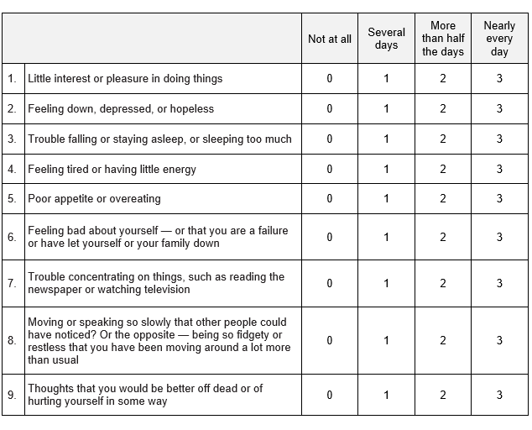
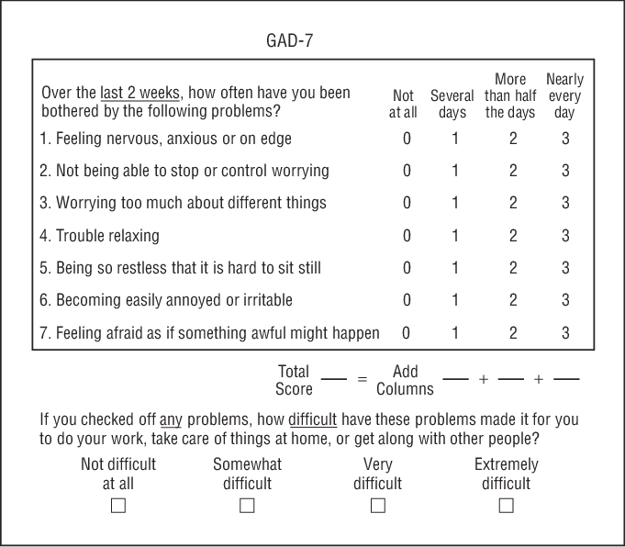
5 domains of prevention
Psychosocial Disorder Prevention – Substance Use Disorders
All adults should be screened for mental health disorders annually
Psychosocial
Depression
Anxiety
Substance Use
Mental Health
PHQ-9
GAD-7
CV disease
Family/ Safety
CASES

Slide 4
5 domains of prevention
Cardiovascular Disease Screening
Hypertension
Annually with office BP if > 40 and/or has risk factors
Psychosocial
Obesity
BMI calculation at each visit
CV disease
ADA
Obesity + RF
A1c/fasting BG/glucose tolerance q3 y
Family/ Safety
Diabetes
USPSTF
Overweight/obese:
A1c/fasting BG/glucose tolerance q3 y
CASES
Low risk: lipid panel q5 y
High risk: lipid panel q3 y
Lipid disorder
AAA
Abdominal US once if + tobacco history
Diet/ Physical activity
All adults should receive counseling on diet/exercise!
20
30
40
50
60
70
80

Slide 5
5 domains of prevention
Family and Safety Planning
Young (<65)
Elderly (>65)
Psychosocial
Family planning
Reproductive goals in reproductive age patients
Ex., HITS: How often does your partner: - Hurt you physically? - Insult you or talk down to you? - Threaten you with harm? - Scream or curse at you?
CV disease
Family/ Safety
Annual screen in reproductive age women
IPV
CASES
Osteo-porosis
DEXA in post-menopausal women + RF
DEXA in all women
+/- high-risk men*
3 key questions:
“Do you feel unsteady when standing or walking?”
“Do you worry about falling?”
“Have you fallen in the past year?”
Falls
Assess at least q1y
Advance care
All patients at least once
*As of 2022, USPSTF states insufficient evidence for screening in men
20
30
40
50
60
70
80

Slide 6


Case 1
Case 2
Case 3
26 yo W presents for an annual exam. Her immunizations are up to date aside from her COVID vaccine, which she declined. She is interested in becoming pregnant with her boyfriend.
VS: Ht 5’ 2”, Wt 175 lb, T 36.8, HR 80, RR 14, BP 138/82
67 yo W with history of HTN on amlodipine coming in to establish care. She lives with her son who manages her finances for her. She is a former smoker and quit 20 years ago. Had a normal colonoscopy 7 years ago, no prior abnormal pap smears. Got the COVID shot at her pharmacy but prior to that had a tetanus shot about 5 years ago. Does not have her records today. Vitals and exam are normal.
69 yo Mwith history of homelessness presenting to establish care. He has a history of smoking in his 20s and drinks about 2 drinks every night. He had a colonoscopy 7 years ago and he remembers them telling him that he needed a repeat scope in 5 years. He is not on any medications. Vitals and exam are unremarkable today.
What screening and prevention is indicated in this patient?
What will you prioritize and why?
What screening and prevention is indicated in this patient?
What will you prioritize and why?
What screening and prevention is indicated in this patient?
What will you prioritize and why?
Cervical cancer screening
STI, HIV and HCV testing (+/- syphilis screening depending on how they classify her risk)
COVID vaccine, influenza vaccine depending on the time of year
Substance use screening
Depression and anxiety screening
HTN and obesity screening
Diet/exercise counseling
Family planning counseling and folic acid supplementation
IPV screening
Advanced care planning
Tdap, PCV20, Shingles, (influenza vaccine depending on the time of year)
Breast cancer screening
Substance use screening (she offers up tobacco hx but need to ask about alcohol and other substances)
Depression and anxiety screening
Obesity screening
Diabetes and lipid disorder screening
Diet/exercise counseling
Fall and osteoporosis screening
Advanced Care Planning
Consideration for elder abuse
Colon cancer screening (colonoscopy)
+/- prostate cancer screening
Tdap, shingles, PCV20 (influenza depending on the time of year)
HIV/HCV screening if not previously performed
Substance use and mental health screening
HTN, obesity, diabetes and lipid disorder screening
AAA screening
Diet/exercise counseling
Fall screening
Advanced Care Planning

Slide 7
Family and Safety Planning
Reproductive goals in reproductive age patients
Ex., HITS: How often does your partner: - Hurt you physically? - Insult you or talk down to you? - Threaten you with harm? - Scream or curse at you?
Family planning
Annual screen in reproductive age women
IPV
DEXA in post-menopausal women + RF
DEXA in all women
or men at high-risk
Osteoporosis
3 key questions:
“Do you feel unsteady when standing or walking?”
“Do you worry about falling?”
“Have you fallen in the past year?”
Falls
Assess at least q1y
Advance care
All patients at least once
20
30
40
50
60
70
80

Slide 8
Cardiovascular Disease Screening
Hypertension
Annually with office BP if > 40 and/or has risk factors
Obesity
BMI calculation at each visit
ADA
Obesity + RF
A1c/fasting BG/glucose tolerance q3 y
Diabetes
A1c/fasting BG/glucose tolerance q3 y
USPSTF
Low risk: lipid panel q5 y
High risk: lipid panel q3 y
Lipid disorder
AAA
Abdominal US once if + tobacco history
Diet/ Physical activity
All adults should receive counseling on diet/exercise!
20
30
40
50
60
70
80

Slide 9
2024–2026 Update — CV Risk, Lipids & Vaccines
Standing teaching (screen all for alcohol/tobacco/drugs + depression [<65 anxiety]; HTN, BMI/obesity, diabetes, AAA men 65–75 ever-smoked; folic acid; falls; DEXA women ≥65; IPV; advance care) verified CURRENT.
NEW — 2026 ACC/AHA Multisociety Dyslipidemia Guideline:
• Use the PREVENT calculator (ages 30–79) for primary-prevention risk — replaces Pooled Cohort Equations, which overestimated risk ~40–50%.
• PREVENT 10-yr risk tiers: low <3%, borderline 3–<5%, intermediate 5–<10%, high ≥10%. "Earlier and lower, for longer."
• LDL targets: very-high-risk <55, high-risk <70, intermediate on statin <100 mg/dL. Start statins earlier in familial hypercholesterolemia / young LDL ≥160 / high 30-yr risk.
• USPSTF statin (primary prevention) still: age 40–75 + ≥1 RF and 10-yr risk ≥10% (Grade B; 7.5–10% selective).
Vaccines (2024 ACIP): PCV21 for adults ≥50 (cases list "PCV20" — PCV20 still valid; PCV21 now an option, age lowered to 50). RSV for ≥75 (and 60–74 high-risk) by shared decision.
Diabetes screening unchanged: ADA — all at 35, or any age if overweight/obese + ≥1 RF; USPSTF 35–70 overweight/obese.

Slide 10
Take-Home Points
Work all five prevention domains every visit (Cancer + ID in Part 1; Psychosocial, Cardiovascular, Family/Safety here) and individualize by age, sex, and risk.
Psychosocial: screen all adults annually for alcohol (SASQ/AUDIT-C), tobacco (every visit), and drug use; depression (all) and anxiety (<65).
Cardiovascular: HTN (office BP, annually if ≥40/at risk), obesity (BMI), diabetes (ADA all at 35), lipids (40–75 + risk), AAA one-time US in men 65–75 who ever smoked.
Family/Safety: folic acid for those who may become pregnant; falls screen ≥65; DEXA women ≥65 (men insufficient evidence); annual IPV screen in reproductive-age women; advance-care planning for all.
2026 ACC/AHA: use PREVENT (not Pooled Cohort) for CV risk; "earlier and lower for longer" LDL targets.

Slide 11
Attribution & Optimization Notes
Adapted from TeachIM.org — “Adult Disease Prevention Part 2: Cardiovascular Disease, Psychosocial Conditions and Family/Safety” (Melton, Guinn, Trefilek; Exec. Ed. Zhang; Sec. Ed. Brett; Univ. of Colorado / Washington). Published Sept 2021, last reviewed May 2024.
Source URL: https://teachim.org/teaching_material/adult-disease-prevention-2/ | Deck: Disease-Prevention-Part-2-2022-updates.pptx (embed-verified)
Licensed CC BY-NC 4.0. This optimized package is likewise CC BY-NC 4.0 — attribution required, non-commercial use only.
Optimized June 2026: original interactive board preserved (all 8 slides, animations & BioRender graphics intact). 2 surgical fixes: "USPTF" → "USPSTF" on slides 5 and 8 (single runs each). 3 slides appended (this addendum).
Currency verified vs 2026 ACC/AHA dyslipidemia guideline (PREVENT), USPSTF (statin, depression/anxiety 2023, AAA, osteoporosis), 2024 ACIP (PCV21), CDC RSV. Companions: teaching script DOCX, CV/Family-Safety learner worksheet PDF, PCE summary PDF.
Educational use only — clinician-reviewed before teaching; guidelines change frequently.

